Slide 1
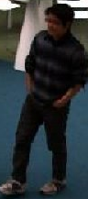
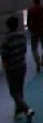
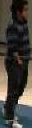
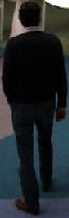
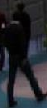
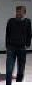
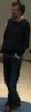
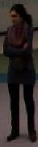
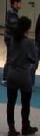
Multi-Camera Person Recogniton
Martin Dahl
Final presentation

Slide 2
Problem definition

Slide 3
Problem definition

Slide 4
Problem definition

Slide 5
Problem definition

Slide 6
Problem definition

Slide 7
Problem definition

Slide 8
Problem definition
?
?

Slide 9
Problem definition

Slide 10
Problem definition

Slide 11
Problem definition

Slide 12
Problem definition

Slide 13
Problem definition

Slide 14
Problem definition

Slide 15
Problem definition
Summary
Synchronize detection from several cameras
Many people in a room or building
Closely related to ReID as worked on previous year

Slide 16
Problem definition
Summary
Synchronize detection from several cameras
Many people in a room or building
Closely related to ReID as worked on previous year
Challenges
Detection
Recognition
Synchronization

Slide 17

Problem definition
Summary
Synchronize detection from several cameras
Many people in a room or building
Closely related to ReID as worked on previous year
Challenges
Detection
Recognition
Synchronization
!
!
!

Slide 18
Problem definition
Summary
Synchronize detection from several cameras
Many people in a room or building
Closely related to ReID as worked on previous year
Challenges
Detection
Recognition
Synchronization

Slide 19
Problem definition
Summary
Synchronize detection from several cameras
Many people in a room or building
Closely related to ReID as worked on previous year
Challenges
Detection
Recognition
Synchronization

Slide 20

Dataset - TeV Hallway [1]
Room with 4 cameras
5 time instances
1 minute at 15 fps per camera per time instance
Approximately 12 unique persons over time
Camera resolution: 800x600
[1] H. Tao, S. Messelodi, O. Lanz. Dynamic task decomposition for decentralized object tracking in complex scenes. Computer Vision and Image Understanding, Vol. 134, pp 89-104, 2015

Slide 21
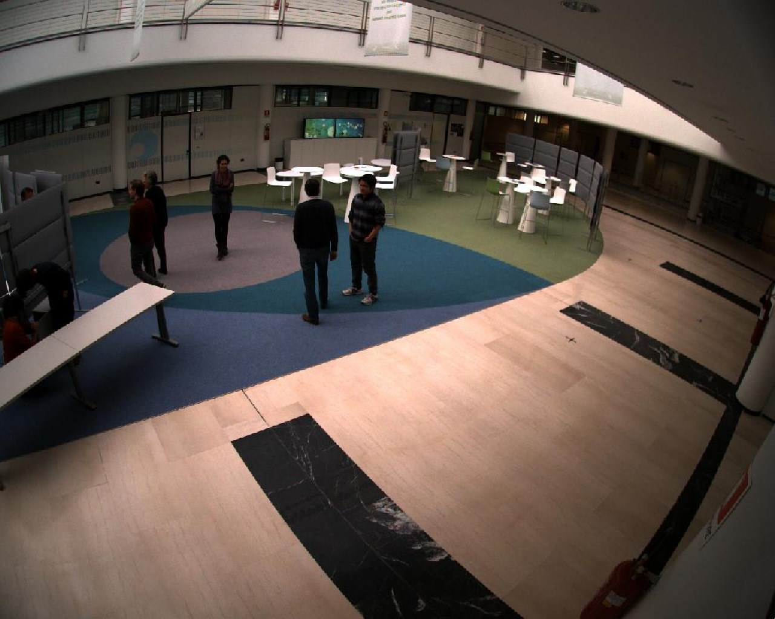
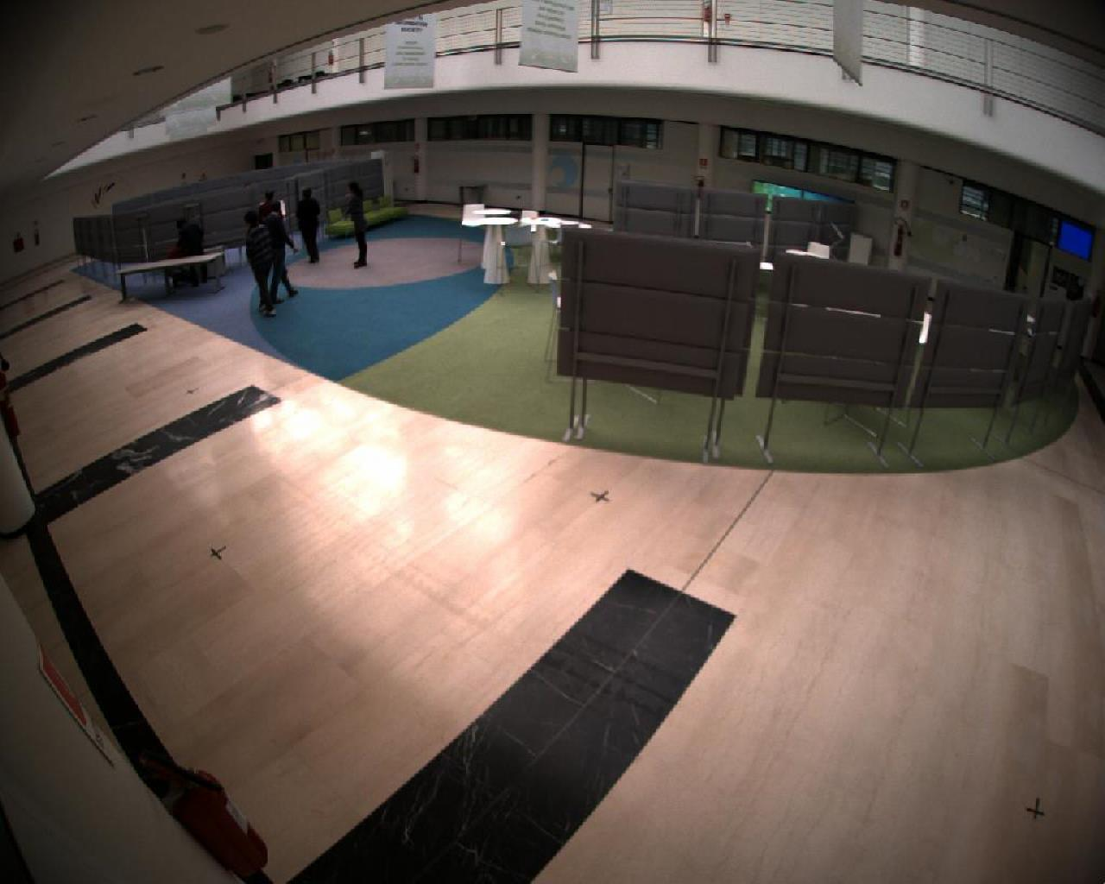
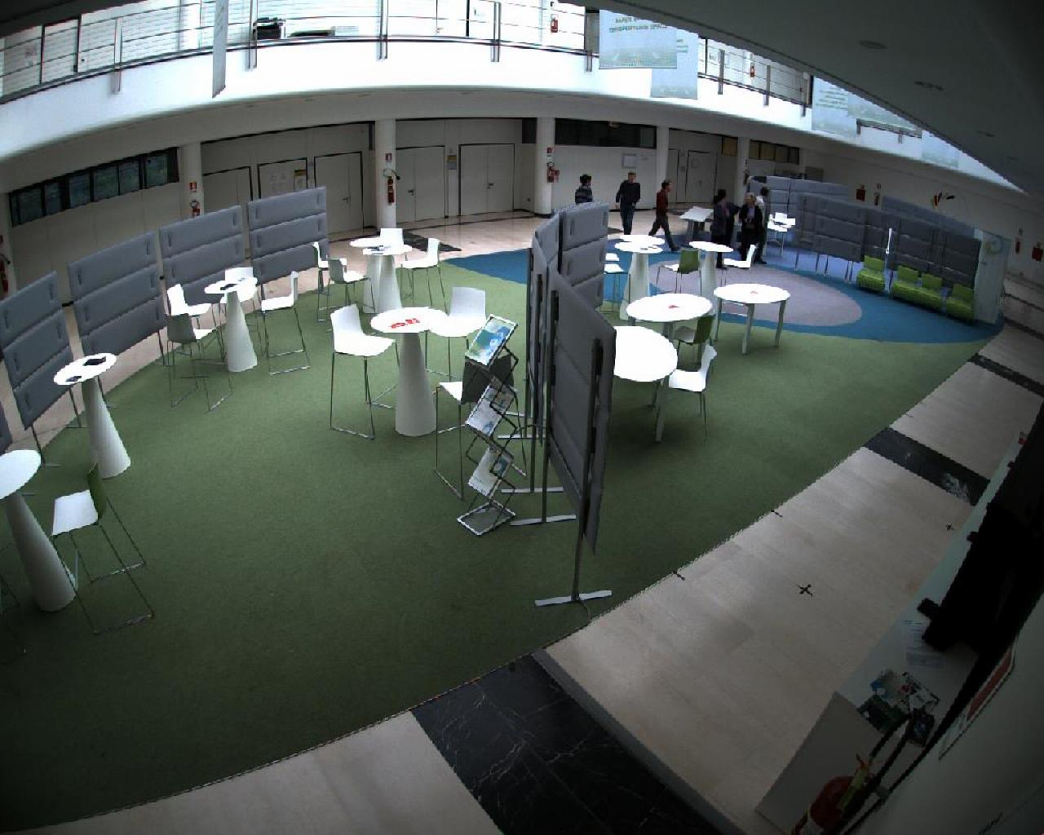
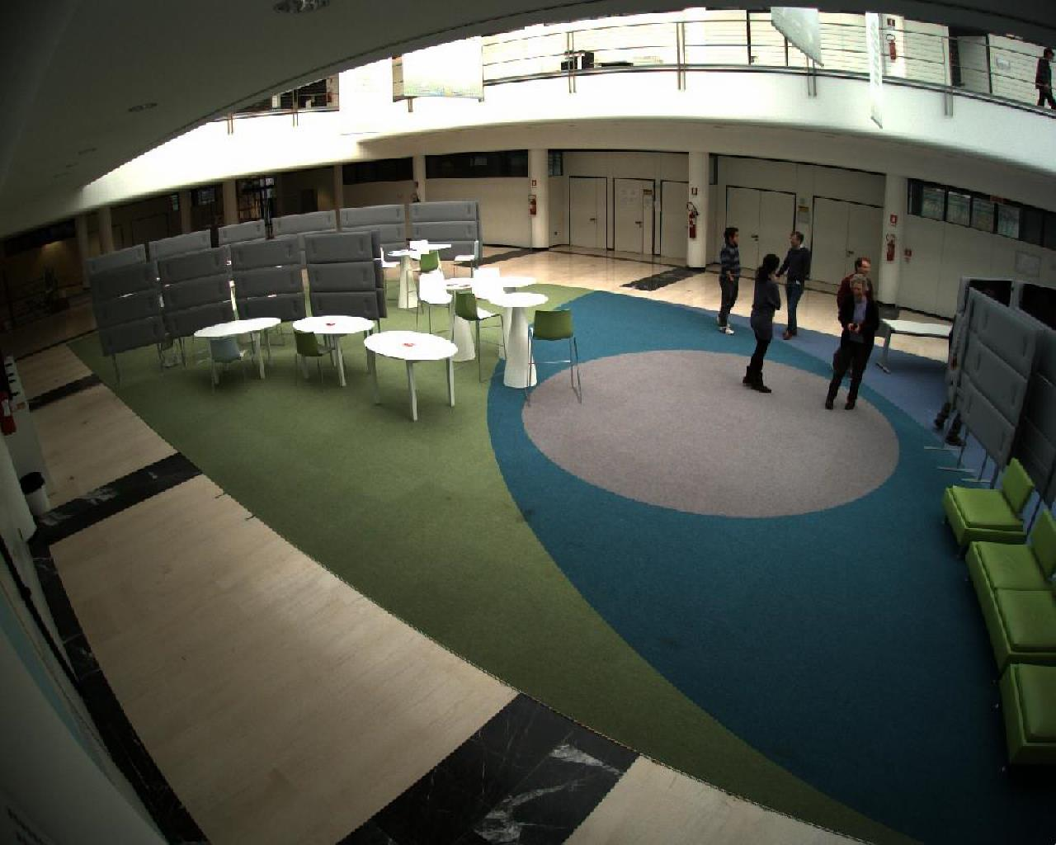
Dataset

Slide 22
Method
1. YOLOv5s [2] for detecting persons
2. Custom dataset generated from TeV hallway dataset
3. ResNet18 [3] for recognizing persons
[2] Ultralytics, “Yolov5,” 2021, February 2021, https://github.com/ultralytics/yolov5
[3] K. He, X. Zhang, S. Ren and J. Sun, "Deep Residual Learning for Image Recognition," 2016 IEEE Conference on Computer Vision and Pattern Recognition (CVPR), 2016, pp. 770-778, doi: 10.1109/CVPR.2016.90.

Slide 23
Method
1. YOLOv5s [2] for detecting persons
2. Custom dataset generated from TeV hallway dataset
3. ResNet18 [3] for recognizing persons
4. Synchronize detection and recognition
[2] Ultralytics, “Yolov5,” 2021, February 2021, https://github.com/ultralytics/yolov5
[3] K. He, X. Zhang, S. Ren and J. Sun, "Deep Residual Learning for Image Recognition," 2016 IEEE Conference on Computer Vision and Pattern Recognition (CVPR), 2016, pp. 770-778, doi: 10.1109/CVPR.2016.90.

Slide 24
Method - 1. YOLOv5s
What is YOLOv5s?
Algorithm for one-shot object detection
Contains Neural Networks
Why YOLOv5s?
Fast
Easy to use
Available pre-trained

Slide 25
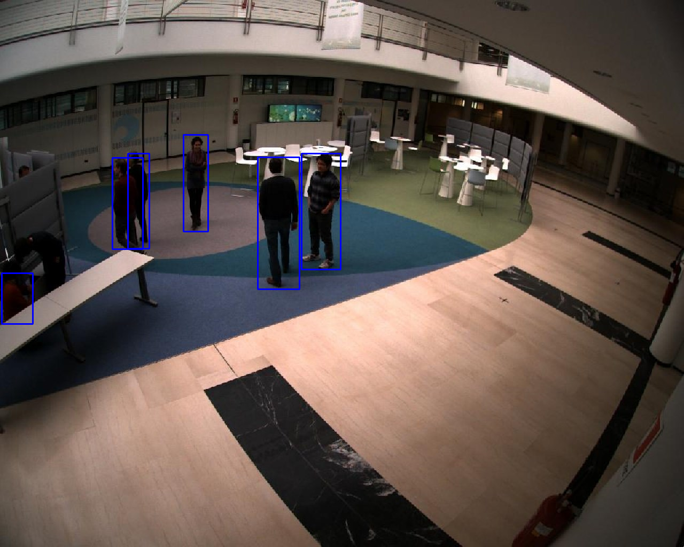
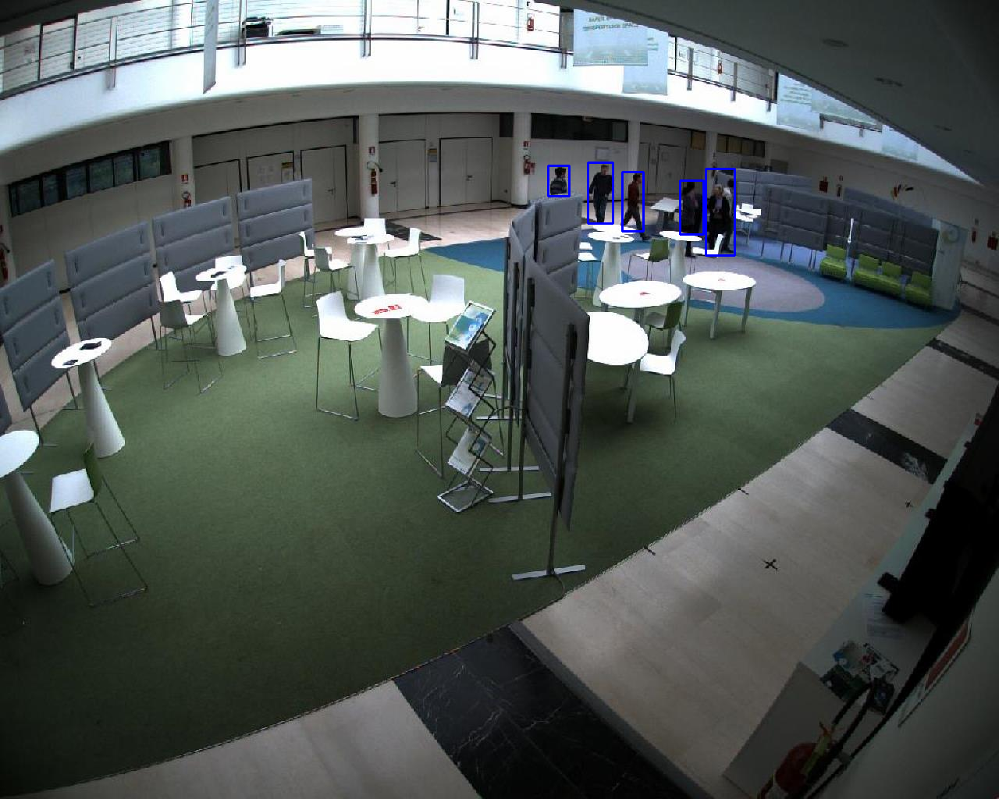
Method - 1. YOLOv5s

Slide 26
Method - 2. Custom dataset

Slide 27
Method - 2. Custom dataset

Slide 28
Method - 2. Custom dataset

Slide 29
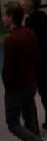
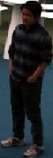
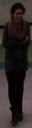
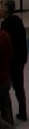
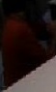
Method - 2. Custom dataset

Slide 30
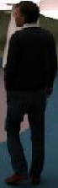
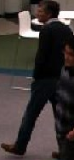
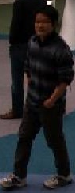
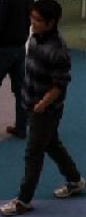
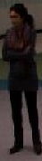
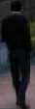
Method - 2. Custom dataset
Person 1
Person 2
Person 3
…

Slide 31
Method - 2. Custom dataset
Person 1
Person 2
Person 3
…
1192 Images representing 10 unique persons

Slide 32
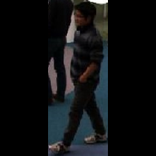
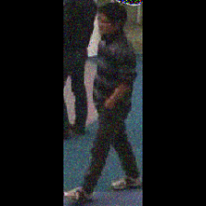
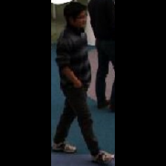
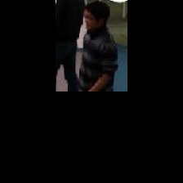
Method - 2. Custom dataset
Image Augmentation
Zero-Padding
Gaussian Noise
Cropping
Horizontal flip

Slide 33
Method - 2. Custom dataset
Image Augmentation
Zero-Padding
Gaussian Noise
Cropping
Horizontal flip
8344 Images representing 10 unique persons

Slide 34
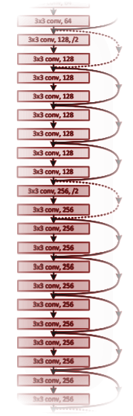
Method - 3. ResNet18
What is ResNet18?
18 layer residual neural network
Why ResNet18?
Light neural network: Fast
Easy to use
Available pre-trained
Enables us to extract features
Original figure from [3]

Slide 35
Method - 3. ResNet18
Concept of feature extraction

Slide 36
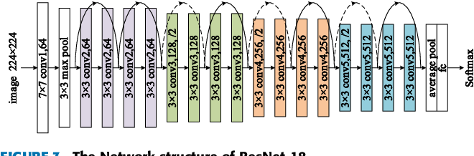
Method - 3. ResNet18
Concept of feature extraction
Zero-pad
Figure of ResNet18 taken from [4]
[4] Ou, Xianfeng et al. “Moving Object Detection Method via ResNet-18 With Encoder–Decoder Structure in Complex Scenes.” IEEE Access 7 (2019): 108152-108160.

Slide 37
Method - 3. ResNet18
Concept of feature extraction
Zero-pad
Figure of ResNet18 taken from [4]
[4] Ou, Xianfeng et al. “Moving Object Detection Method via ResNet-18 With Encoder–Decoder Structure in Complex Scenes.” IEEE Access 7 (2019): 108152-108160.

Slide 38
Method - 3. ResNet18
Concept of feature extraction
512 dimensional feature vector!
Zero-pad
Figure of ResNet18 taken from [4]
[4] Ou, Xianfeng et al. “Moving Object Detection Method via ResNet-18 With Encoder–Decoder Structure in Complex Scenes.” IEEE Access 7 (2019): 108152-108160.

Slide 39
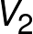
Method - 3. ResNet18
Concept of feature extraction
Original figure of ResNet18 taken from [4]
Original figure of ResNet18 taken from [4]
[4] Ou, Xianfeng et al. “Moving Object Detection Method via ResNet-18 With Encoder–Decoder Structure in Complex Scenes.” IEEE Access 7 (2019): 108152-108160.

Slide 40
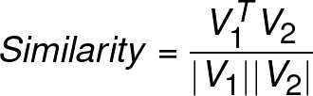
Method - 3. ResNet18
Concept of feature extraction

Slide 41
Method - 3. ResNet18
Concept of feature extraction

Slide 42
Method - 3. ResNet18
Concept of feature extraction

Slide 43
Method - 3. ResNet18
Goal
Low similarity for different people
High similarity for same person

Slide 44
Method - 4. Synchronization

Slide 45
Method - 4. Synchronization
CAMERA 1
CAMERA 2
CAMERA 3
CAMERA 4

Slide 46
Method - 4. Synchronization
CAMERA 1

Slide 47
Method - 4. Synchronization
Detect persons
CAMERA 1

Slide 48
Method - 4. Synchronization
Detect persons
CAMERA 1
Extract features
[5,12,7,1,7,1,2…]
[7,1,2,2,7,1,6,1…]
[105,7,1,2,6,1,4…]

Slide 49
Method - 4. Synchronization
Detect persons
CAMERA 1
Extract features
Save features, bbox and coordinate for each detected person
[5,12,7,1,7,1,2…]
[7,1,2,2,7,1,6,1…]
[105,7,1,2,6,1,4…]

Slide 50
Method - 4. Synchronization
Detect persons
Detect persons
CAMERA 1
CAMERA 2
CAMERA 2
Extract features
Extract features
Save features, bbox and coordinate for each detected person
[5,12,7,1,7,1,2…]
[7,1,2,2,7,1,6,1…]
[105,7,1,2,6,1,4…]
[5,12,7,1,7,1,2…]
[7,1,2,2,7,1,6,1…]
[105,7,1,2,6,1,4…]
Save features, bbox and coordinate for each detected person
Detect persons
Detect persons
CAMERA 3
CAMERA 3
CAMERA 4
CAMERA 4
Extract features
Extract features
Save features, bbox and coordinate for each detected person
[5,12,7,1,7,1,2…]
[7,1,2,2,7,1,6,1…]
[105,7,1,2,6,1,4…]
[5,12,7,1,7,1,2…]
[7,1,2,2,7,1,6,1…]
[105,7,1,2,6,1,4…]
Save features, bbox and coordinate for each detected person

Slide 51
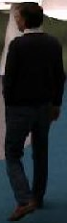
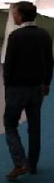

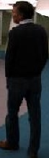
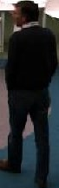
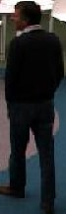
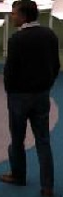
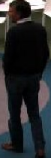
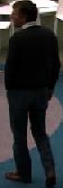
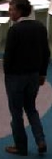
Method - 4. Synchronization
What about frame to frame?
Detect people again, get features again
Try to match new bbox and features with previous
If match: Update bbox and average features

Slide 52
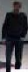
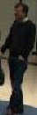
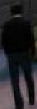
Method - 4. Synchronization
What about camera to camera?
Select one person from any camera
Match selected person on features of persons in remaining cameras

Slide 53
Results - Explanation
What will we see?
4 camera views
Green number: Frame number
White number: Number of detected persons in camera
We select person 0 in upper right camera, try to find person in remaining cameras!
Selected person marked by green bounding box

Slide 54
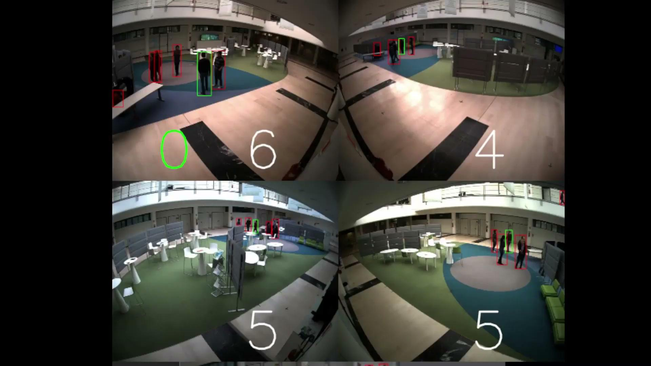
Results - Instance 0 (Train instance)

Slide 55

Results - Instance 1

Slide 56
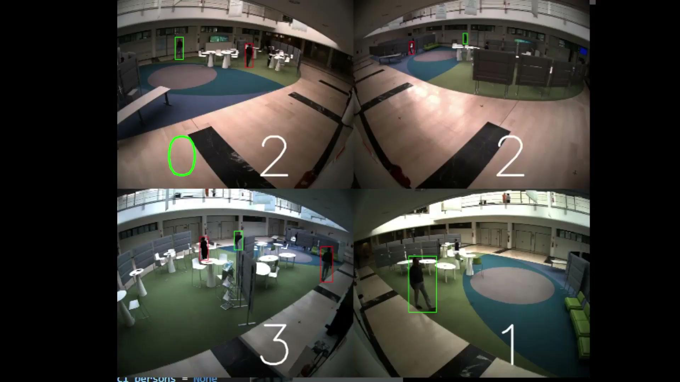
Results - Instance 2

Slide 57

Results - Instance 3

Slide 58
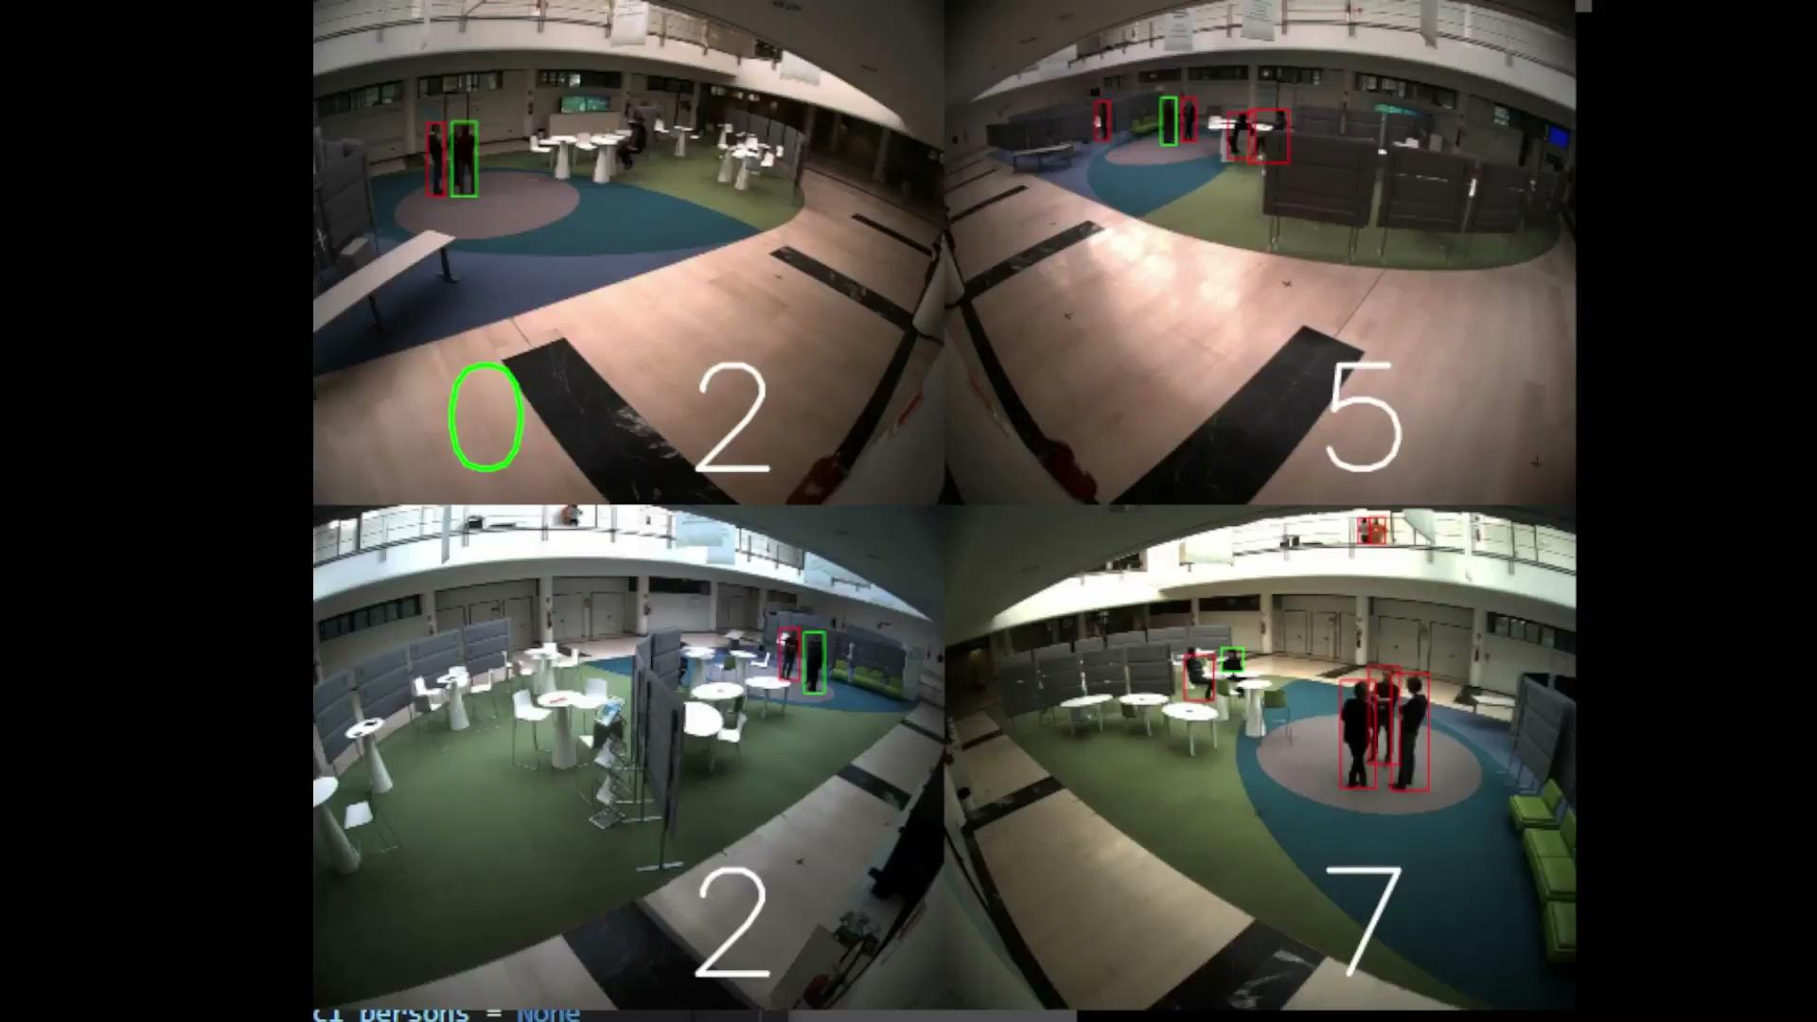
Results - Instance 4

Slide 59
Suggestions for further work
Use more data such as Market-1501 [6]
Implement AlignedReID [5] instead of only ResNet18
Implement person tracker from [1]
[5] Zhang, Xuan & Luo, Hao & Fan, Xing & Xiang, Weilai & Sun, Yixiao & Xiao, Qiqi & Jiang, Wei & Zhang, Chi & Sun, Jian. (2017). AlignedReID: Surpassing Human-Level Performance in Person Re-Identification.
[6] L. Zheng, L. Shen, L. Tian, S. Wang, J. Wang and Q. Tian, "Scalable Person Re-identification: A Benchmark," 2015 IEEE International Conference on Computer Vision (ICCV), 2015, pp. 1116-1124, doi: 10.1109/ICCV.2015.133.
[1] H. Tao, S. Messelodi, O. Lanz. Dynamic task decomposition for decentralized object tracking in complex scenes. Computer Vision and Image Understanding, Vol. 134, pp 89-104, 2015

Slide 60
References
[1] H. Tao, S. Messelodi, O. Lanz. Dynamic task decomposition for decentralized object tracking in complex scenes. Computer Vision and Image Understanding, Vol. 134, pp 89-104, 2015
[2] Ultralytics, “Yolov5,” 2021, February 2021, https://github.com/ultralytics/yolov5
[3] K. He, X. Zhang, S. Ren and J. Sun, "Deep Residual Learning for Image Recognition," 2016 IEEE Conference on Computer Vision and Pattern Recognition (CVPR), 2016, pp. 770-778, doi: 10.1109/CVPR.2016.90.
[4] Ou, Xianfeng et al. “Moving Object Detection Method via ResNet-18 With Encoder–Decoder Structure in Complex Scenes.” IEEE Access 7 (2019): 108152-108160.
[5] Zhang, Xuan & Luo, Hao & Fan, Xing & Xiang, Weilai & Sun, Yixiao & Xiao, Qiqi & Jiang, Wei & Zhang, Chi & Sun, Jian. (2017). AlignedReID: Surpassing Human-Level Performance in Person Re-Identification.
[6] L. Zheng, L. Shen, L. Tian, S. Wang, J. Wang and Q. Tian, "Scalable Person Re-identification: A Benchmark," 2015 IEEE International Conference on Computer Vision (ICCV), 2015, pp. 1116-1124, doi: 10.1109/ICCV.2015.133.

